Slide 1
Cloud Computing
SEWP ZG527

Slide 2
Outline
Virtual infrastructure managers
Architectural view on OpenNebula
Constructing a Private cloud
Virtual Machines in OpenNebula
Constructing a Hybrid cloud

Slide 3
Virtual Infrastructure Managers
Need of the hour???
Notes:
RL 6.2

Slide 4



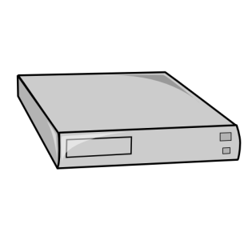
Why a Virtual Infrastructure Manager?
VMs are great!!...but something more is needed
Where did/do I put my VM? (scheduling & monitoring)
How do I provision a new cluster node? (clone)
What IP addresses are available? (networking)
Provide a uniform view of the resource pool
Life-cycle management and monitoring of VM
The VIM should integrate Image, Network and Virtualization
VM
VM
VM
VM
OpenNebula (VIM)
hypervisor
hypervisor
hypervisor
hypervisor

Slide 5
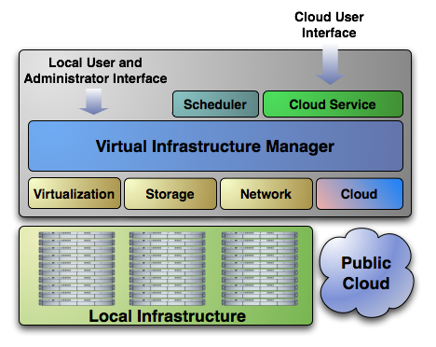
Extending the Benefits of Virtualization to Clusters
Dynamic deployment and re-placement of virtual machines on a pool of physical resources
Transform a rigid distributed physical infrastructure into a flexible and agile virtual infrastructure
Backend of Public Cloud: Internal management of the infrastructure
Private Cloud: Virtualization of cluster or data-center for internal users
Cloud Interoperation: On-demand access to public clouds
Notes:
5
Datacenters for flexibility providing services
Cloud providers willing to offer their static infrastructure

Slide 6
Virtual Machine Management Model
Distributed VM Management Model
Notes:
6
Datacenters for flexibility providing services
Cloud providers willing to offer their static infrastructure

